Slide 1
7th Cycle Regional Housing Needs Allocation

Slide 2
Welcome and Introductions
Today’s speakers
Chelsea Lee, SACOG
Jennifer Gastelum, PlaceWorks
Matt Kowta, BAE
Chelsey Payne, Ascent

Slide 3
Polling Activity

Slide 4
Polling Activity

Slide 5
Questions We’ll Cover…
What is RHNA?
What is the objective of RHNA?
What is the RHNA process?
What factors are considered in the RHNA process?
What requirements have changed since the last RHNA Cycle?
How does RHNA define affordability?
What happens if jurisdictions can’t timely adopt their new Housing Elements?

Slide 6
What is RHNA?

Slide 7
Regional Housing Needs Allocation(RHNA)
State-required process to determine how many housing units (by affordability) each jurisdiction must plan for in the Housing Element of its General Plan
Upcoming 7th Cycle for the SACOG region covers the Housing Element period May 15, 2029 – May 15, 2037
Mandates planning and accommodating housing development NOT building housing

Slide 8
What is the objective of RHNA?

Slide 9
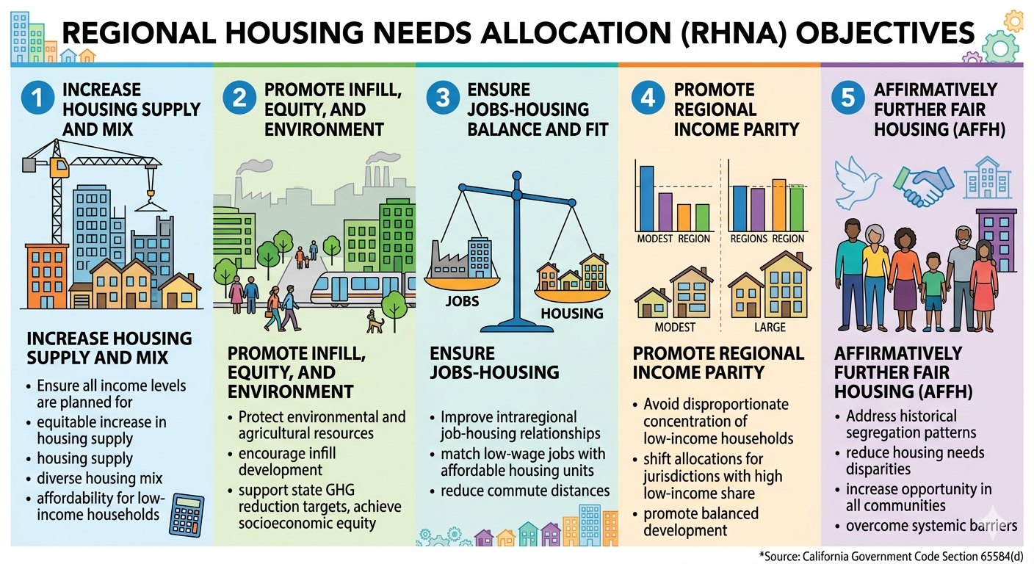

Slide 10
What is the RHNA process?

Slide 11
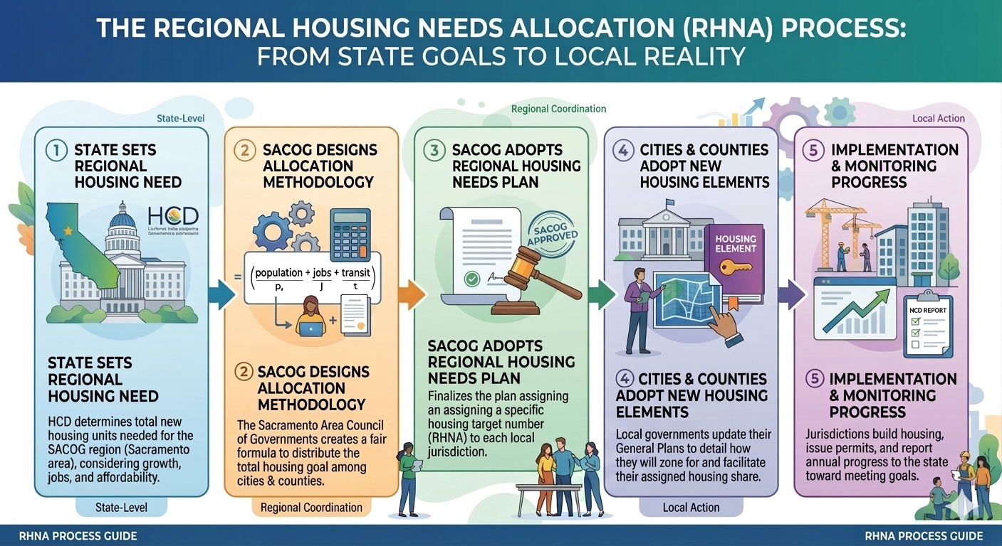

Slide 12
What factors are considered in the RHNA process?

Slide 13
Factors Used to Determine Housing Need
14 factors are considered during the RHNA process:
  Jobs and housing relationship
  Sewer and water capacity
  Distribution of household growth in MTP/SCS
  Agreements to direct growth more sustainably
  Loss of assisted housing developments
  Housing cost burden
  Needs of farmworkers
  Rates of overcrowding
  Needs of college students
  Needs of unhoused population
  Housing lost during a declared emergency
  Region's GHG emissions targets
  SCS development pattern
  Other proposed factors

Slide 14
What requirements have changed since the last RHNA cycle?

Slide 15
New Factors Considered in the 7th Cycle
Housing Need and Affordability
  Separate income categories for acutely low (<15%) and extremely low (<30%) income households
  Cost burdened and overcrowded households compared nationally
    Cost Burdened: A household spending more than 30% of its gross income on housing (including rent/mortgage and utilities) is considered cost burdened.
    Overcrowded: An overcrowded unit as one occupied by more than 1 person per room (excluding bathrooms and kitchens). Units with more than 1.5 persons per room are severely overcrowded.

Slide 16
New Factors Considered in the 7th Cycle
Homelessness
  HCD must identify housing needs for those experiencing homelessness and local governments must plan to meet those needs in their Housing Elements, potentially increasing the overall capacity
  HCD must consult with SACOG for the homelessness data such as Point-in-Time (PIT) Counts or HMIS (Homeless Management Information System) numbers
Climate
  Sea level rise, wildfire risk, and evacuation capacity considered

Slide 17
Process and Planning in the 7th Cycle
Regional Coordination
  RHNA allocation must “consider” SACOG’s Regional Transportation Plan
  Subregion allocations must mirror proportional share from 6th cycle
Timeline
  HCD must provide the regional housing needs determination 3 years before the Housing Element deadline. Housing Element period May 15, 2029 – May 15, 2037
    Housing Element Due Date May 15, 2029
  HCD methodology and allocation review times reduced
    HCD has to review an adopted RHNA methodology in 45 days (previously 90 days)
    HCD has to determine if a final allocation plan is consistent in 15 days (previously 30 days)

Slide 18
How does RHNA define affordability?

Slide 19
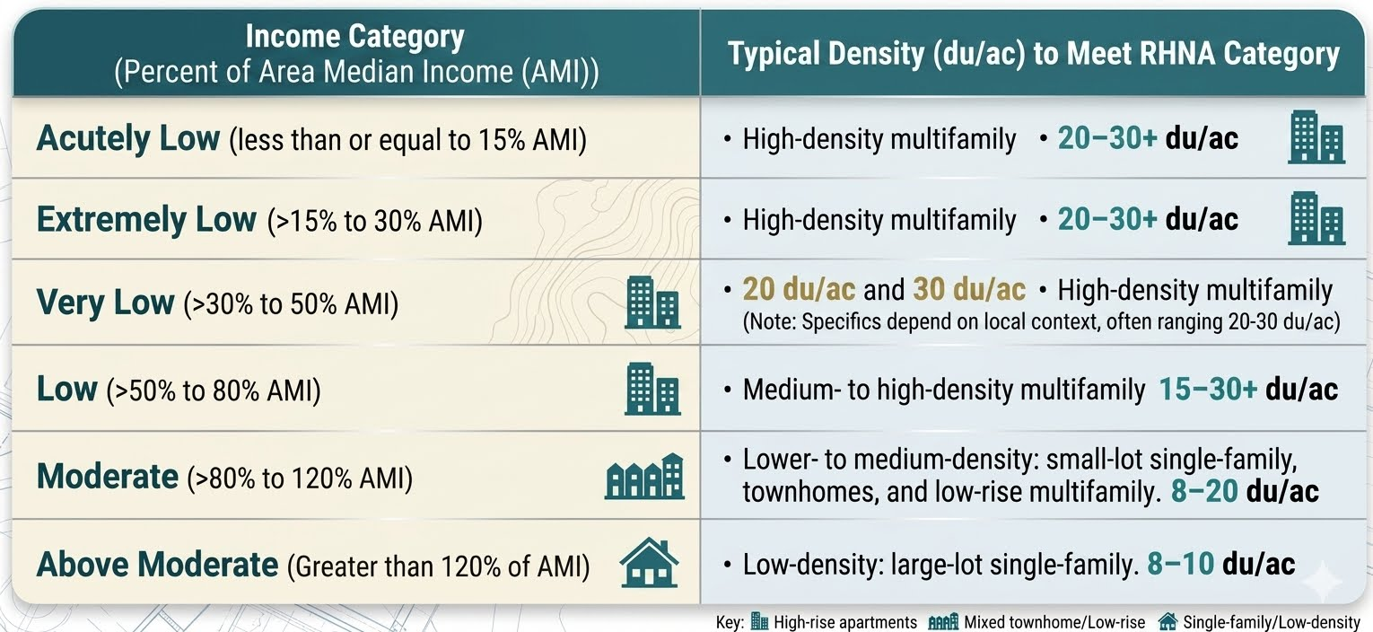
RHNA Affordability and Density

Slide 20
What if jurisdictions can’t timely adopt their Housing Elements?

Slide 21
Consequences of Non-Compliance
HCD enforcement actions
  Financial penalties
  Suspension of local permitting authority
  Acceleration of Housing Element update cycles (8 year to 4 year)
Loss of local zoning control
  Mandatory rezoning with by-right approvals
  “Builder’s Remedy” – developers may bypass zoning standards and build at higher densities

Slide 22
RHNA Project Updates

Slide 23

Cycle 7 RHNA and Housing Element
Project Timeline
Board Adopts Single
Methodology
November 2027
Board Adopts Final
RHNA Plan
Cycle 7 Housing Elements Due
December 2027
May 15, 2029
Release RHNA
Methodology
Menu Options
SACOG Provides
Housing Element TA
TAC
Meetings
May – July 2027
2028
Summer 2026
Q1
Q2
Q3
Q4
Q1
Q2
Q3
Q4
Q1
Q2
Q3
Q4
Q1
Q2
Q3
Q4
2026
2027
2028
2029

Slide 24
2026 RHNA Milestones
JULY:
By July 15, 2026 – HCD consultation with SACOG on “big number”
AUGUST:
August 24th Board Meeting - Staff will provide an overview on consultation and offer staff recommendation in preparation for Board action on “big number”
TAC begins meeting for methodology exploration
SEPTEMBER:
By September 15, 2026 – SACOG receives “big number” from HCD
September 24th Board Meeting - Action to accept or challenge the State-issued Regional Determination on specific grounds
OCTOBER-DECEMBER:
Methodology exploration continues into April 2027

Slide 25
Technical Advisory Committee
TAC Meetings (mark your calendars!)
  8 total, monthly into Spring 2027, 10-12, light snacks/brunch provided
  Please designate one (1) representative for your jurisdiction, with an alternate
SACOG Board Room, other locations?
External partners’ feedback through subcommittee(s)

Slide 26
TAC Meeting Dates (mark your calendars!)
  August 18, 2026
  September 1, 2026
  October 13, 2026
  November 10, 2026
  December 8, 2026
  January 12, 2027
  February 9, 2027
  March 9, 2027

Slide 27
HCD Consultation
Reviewing sample RHNDs
Informal HCD consultation
HCD Data Requested – any thoughts from this group?
Expected increase
Adjustment factors most likely to increase RHND:
  Vacancy
  Overcrowding (higher in region compared to national rates)
  Cost burden (new HCD methodology)

Slide 28
RHND Comparisons by COG

Slide 29
Technical Assistance Needs
SACOG Scope of Work includes:
  Data Package
  ADU Affordability Survey
  Regional AFFH Analysis
AB 2002 and updates on consulting bench
Housing Element consultants
Others (templates, sample ordinances, studies, etc.)

Slide 30
Q&A

Slide 31
Thank you!

